Slide 1


Slide 2
Project Purpose: HR Data Analysis Dashboard
In today's competitive business landscape, organizations are constantly seeking innovative ways to optimize their workforce and drive sustainable growth. One critical aspect of this endeavor is effectively managing human resources, with a particular focus on improving employee performance and retention. To achieve these objectives, organizations are increasingly turning to data-driven insights provided by HR analytics tools. Among these, Microsoft Power BI stands out as a powerful platform for visualizing and analyzing HR data, enabling organizations to make informed decisions that positively impact employee engagement and organizational success. 📈🛍️
Leveraging HR Data Analysis for Organizational Excellence
📌 Data-Driven Workforce Optimization: Utilizing HR analytics to gain insights into workforce trends and behaviors.
📌 Performance & Retention: Analyzing employee data to identify drivers of performance and factors influencing retention.
📌 Strategic HR Management: Employing tools like Microsoft Power BI to visualize HR metrics and inform strategic decisions.
📌 Employee Engagement: Interpreting analytics to improve engagement and foster a positive work environment.
By embracing HR data analysis, organizations can not only anticipate and address workforce challenges but also unlock opportunities for growth and success. 📈🛍️

Slide 3
Skills Utilized in Crafting HR Dashboard Report
📌 Data Analysis
Proficient in extracting and interpreting complex employee data to identify trends and insights.
📌 Data Visualization
Skilled in designing clear and impactful visual representations of HR metrics using various chart types.
📌 UX Design
Applied user experience principles to create an intuitive and accessible dashboard interface.
📌 Presentation Skills
Effective in summarizing and presenting data-driven findings to inform HR strategies and decisions.
Tools Used
[ MS Excel and Power BI ]

Slide 4
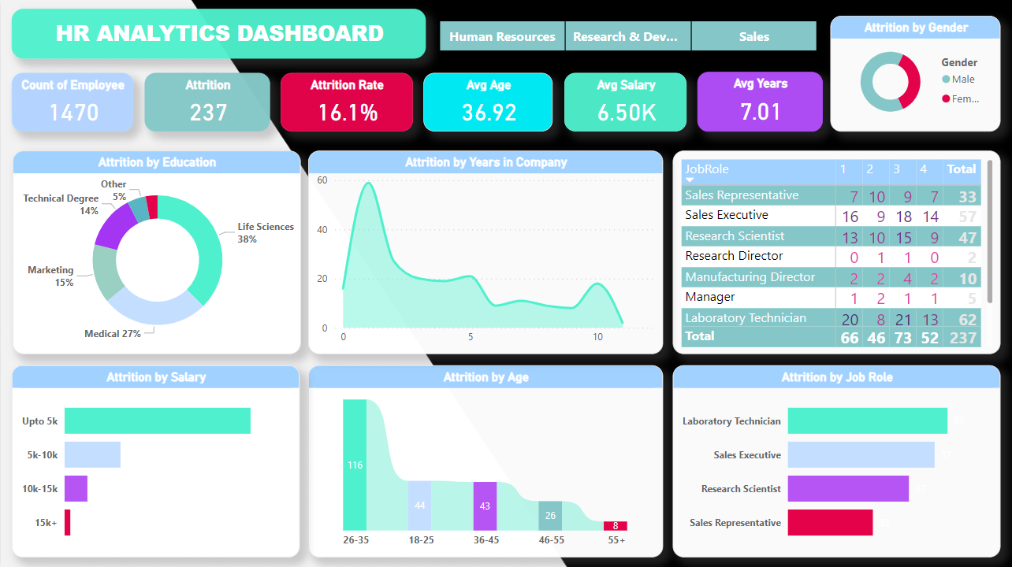

Slide 5
HR Data Analytics Performance Overview
The primary goal of this HR analytics dashboard is to empower organizations to improve employee performance and retention rates by leveraging insightful data analysis. By identifying key factors contributing to attrition and implementing targeted strategies, organizations can enhance their hiring processes, optimize employee experiences, and ultimately foster a more productive workforce. This dashboard highlights key areas for HR to focus on to improve retention and manage the workforce effectively. 📈📊
Monitor Workforce Dynamics: Track employee count, attrition rate, average age, salary, and tenure to understand the workforce composition.
Analyze Attrition Factors: Identify patterns in attrition related to education, salary, age, and job role to develop targeted retention strategies.
Inform HR Decisions: Use data-driven insights to make informed decisions on recruitment, development, and employee engagement initiatives.
Enhance Strategic Planning: Leverage analytics to support strategic planning and improve overall organizational health.
📌 This dashboard serves as a vital tool for HR professionals to proactively manage and optimize the company’s human capital.

Slide 6
Once collected, this raw data is processed, cleaned, and transformed into a structured format. Analytical tools and business intelligence platforms, such as Power BI as mentioned in previous responses, are then used to perform in-depth analysis and derive meaningful insights. As the business landscape continues to evolve, HR analytics will play an increasingly vital role in driving organizational success. 📈🛍️

